Slide 1
NextHikes IT SOLUTIONS- Project 5 User Analytics in the Telecommunication Industry
BY: AVANTIKA VERMA

Slide 2
AGENDA
PROJECT OVERVIEW
DATA ANALYSIS
Customer Device Insights
User Behaviour Insight
User Engagement
Engagement Clustering Insight
User Satisfaction Insights
MYSQL
STREAMLIT APP
SWOT Analysis – TellCo Telecom OpportunityModel Accuracy
Strategic Assessment
Final Recommendation

Slide 3
PROJECT overview
Purpose:
To assess the investment potential of TellCo, a mobile service provider in the Republic of Pefkakia, through a deep analysis of customer behavior and telecom usage data.
Objective:
Deliver actionable insights and a recommendation on whether to acquire TellCo, based on real network activity and growth opportunities.
Scope of Work:
Analyze telecom session data (calls, SMS, app & internet usage)
Identify high-value users, top devices & apps
Segment customers by behavior and usage intensity
Perform SWOT analysis and revenue modeling
Present data-driven acquisition recommendation
Outcome:
A business proposal presentation backed by visual insights, plus a strategic roadmap highlighting how data-driven decisions can unlock TellCo’s full potential

Slide 4
DATA ANALYSIS
Dataset Overview:
Records: 150,001 | Columns: 55 | Size: ~63 MB
Telecom session-level detail records (xDR format)
User & Device Identifiers
MSISDN (Primary ID), IMSI, IMEI
Device Info: Handset Manufacturer & Type
Note: Some identifiers contain missing values
Data Types:
Numerical Features: 50
Categorical Features: 5
Target Variable: Satisfaction Score
Use Case Opportunities:
Subscriber Behavior Modeling
App Usage & Engagement Analysis
Device Segmentation
Network Performance Evaluation

Slide 5
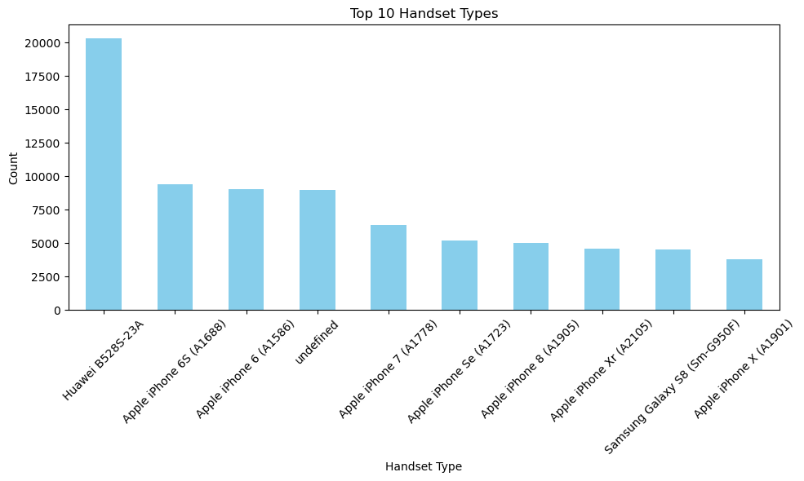
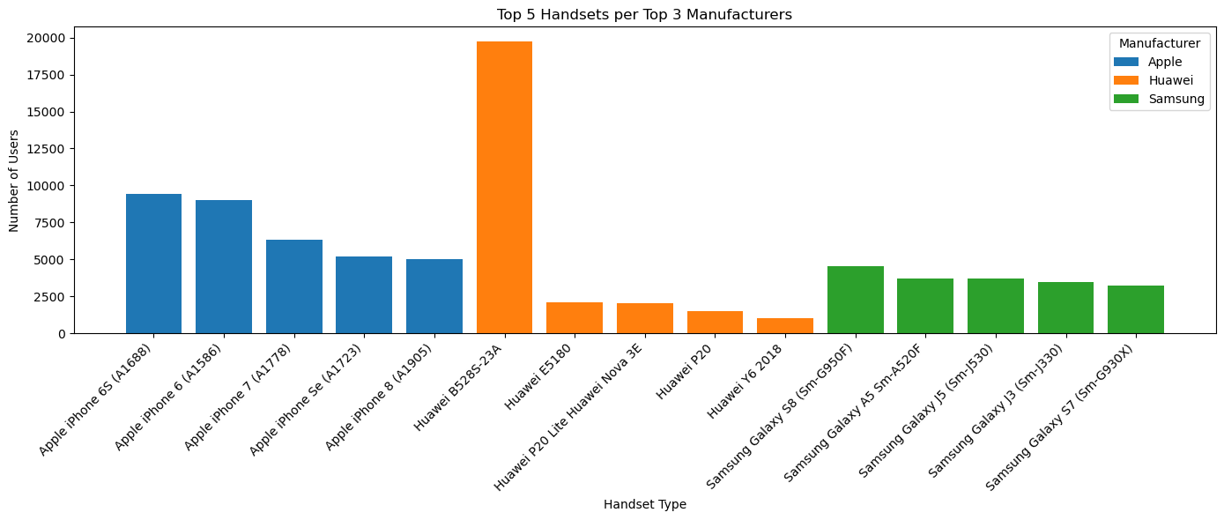
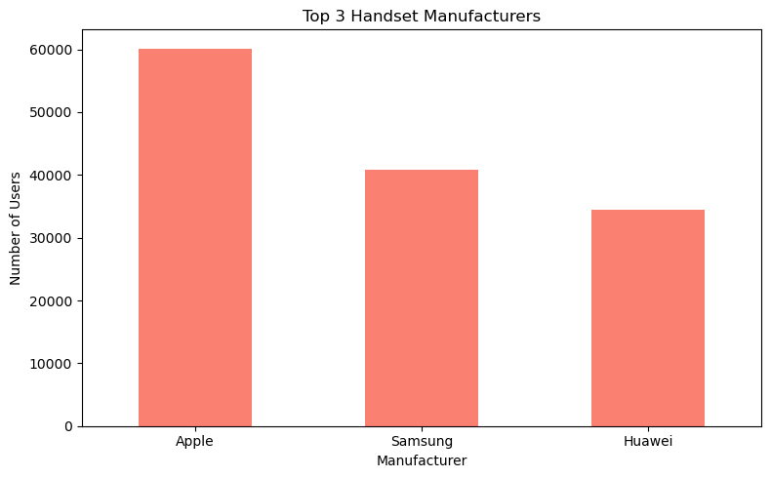
Customer Device Insights

Slide 6
Customer Device Insights
Top Device Segments
Apple (59,000+): Premium, brand-loyal users
Samsung (40,000+): Mid-range, value-driven users
Huawei B528S-23A (19,000+): Fixed-home router users
Undefined Devices (~9,000): Data quality issue with targeting potential
Strategic Opportunities
Apple → Launch premium bundles with Apple Music, iCloud & upgrade perks
Huawei B528S → Bundle smart home plans: high data + connected devices
Samsung → Promote "Switch & Save" offers: cashbacks, flexible contracts
Undefined → Enrich data to enable retargeting and unlock hidden users
Business Impact
Targeted campaigns = Higher ROI
Improved data = Reveal valuable user segments
Tailored offers = Increased loyalty & revenue growth
Our analysis reveals that Apple, Huawei, and Samsung dominate the telecom device landscape, with Apple leading significantly.

Slide 7
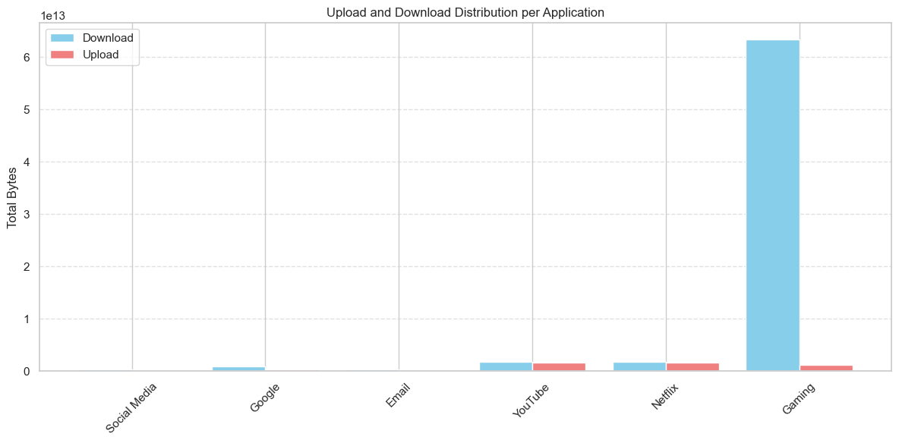
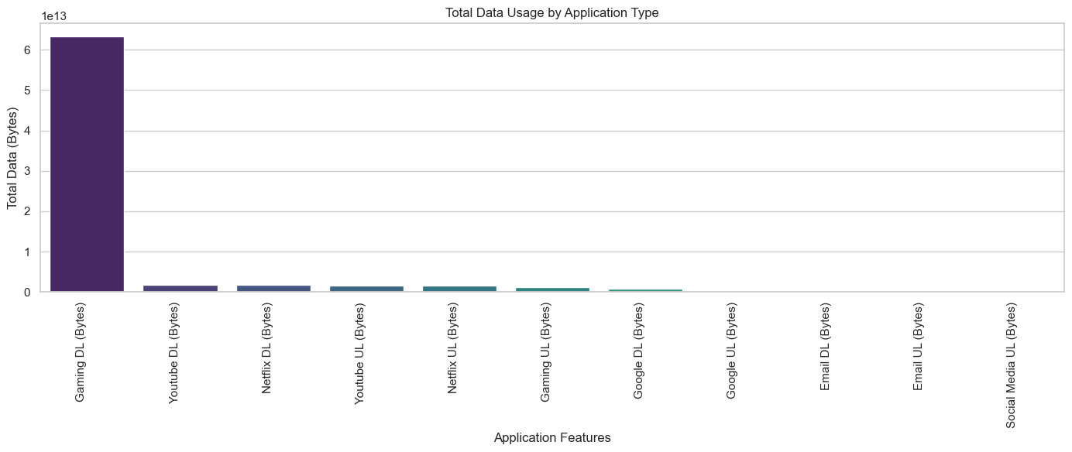
User behavior Insights
Key Data Insight:
Gaming Downloads exceed 6 × 10¹³ bytes — more than all other categories combined
YouTube, Netflix, Google, Email, and Social Media trail far behind in data usage
Highlights a clear and concentrated demand from the gaming segment

Slide 8
User behavior Insights
Why It Matters for Investors?
Impact
Strategic Recommendation:
Invest in Gaming-Specific Capabilities
Prioritize bandwidth allocation and QoS for gaming
Develop exclusive partnerships (e.g., with publishers or platforms)
Use data to predict and pre-empt gaming trends
 | AREA | IMPACT
1. | Network Infrastructure | Optimize for high-throughput, low-latency performance to serve gaming demand efficiently.
2. | Revenue Growth | Introduce gaming-centric bundles with high data caps or zero-rated access.
3. | Market Differentiation | Position as a gamer-preferred network with specialized offers and enhanced performance.
4. | User Acquisition & Retention | Gaming community = loyal, high-data-consuming audience ripe for engagement.

Slide 9
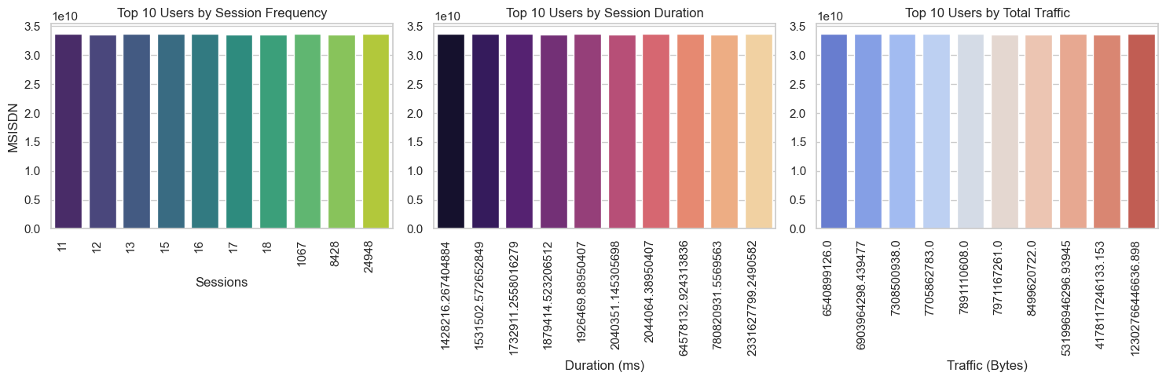
User ENGAGEMENT Insights

Slide 10
User ENGAGEMENT Insights
Key Insights from User Analytics:
Business Implications for Buyer Consideration
Power Users = Premium Opportunity:- Monetize through high-tier plans, exclusive perks, or loyalty programs
Personalized Retention:- Retarget with custom offers to reduce churn and deepen engagement
Service Optimization:- Analyse power user patterns to fine-tune network performance and app experiences
Strategic Next Steps
Segment and profile top users for personalized engagement
Launch targeted marketing for heavy users (streaming, gaming, productivity)
Explore upsell potential with bundled premium services or data add-ons
Metric Type | Key Findings | User Behaviour
Session Frequency (Left Chart) | Users like 11, 12, 13... are the most active | High engagement & app dependency
Session Duration (Middle Chart) | Users such as 1428218..., 535152... stay online longest | Consuming long-form content (streaming, gaming, video calls)
Total Traffic (Right Chart) | Users like 6540899..., 6890594..., 7708059... use the most data | Engaged in data-heavy activities (HD video, downloads, cloud sync)

Slide 11
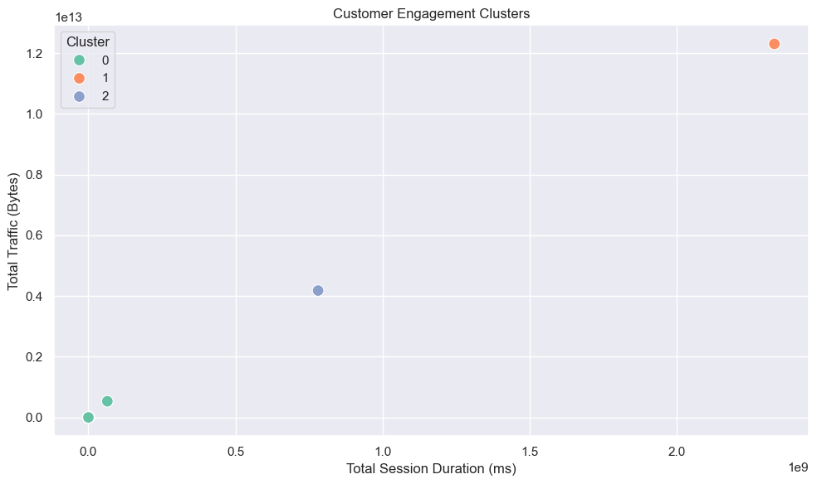
User ENGAGEMENT CLUSTERING
Segment | User Behavior | Likely User Type
Cluster 1: High Engagement | Highest traffic & session duration. Power users in streaming, gaming, or professional apps | Streamers, gamers, remote professionals
Cluster 0: Low Engagement | Low traffic and short sessions. Minimal app interaction | Casual, inactive, or trial users
Cluster 2: Moderate Engagement | Moderate traffic and session time. Regular but not intensive use | Routine users (news, social, light media)
This segmentation helps identify high-value users who should be targeted for premium services, as well as low-value users who may need re-engagement. By understanding each group's unique behaviors, businesses can implement tailored strategies for maximizing user retention and growth.

Slide 12
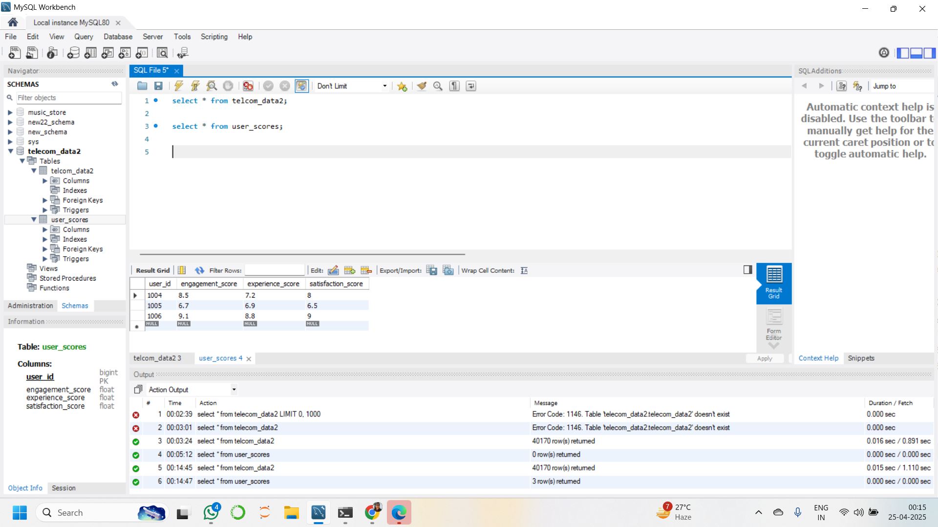
Mysql

Slide 13
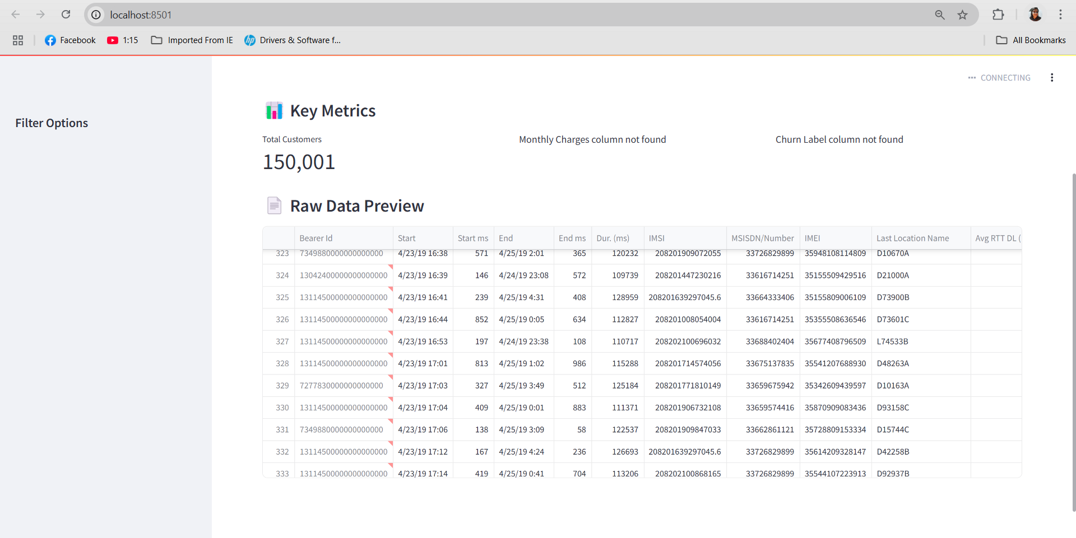
STREAMLIT APP.py

Slide 14
SWOT Analysis – TellCo Telecom Opportunity
Strengths | Weaknesses
Robust User Base: High engagement levels and device activity across key applications like YouTube, Netflix, and Social Media. Behavioral Clustering Available: Segmented insights enable immediate targeting of high-value users. Network Utilization Transparency: Application-level breakdown of network load allows for cost-effective network resource allocation. Data-Backed Decision Support: Predictive satisfaction scoring and machine learning clustering provide foresight, not just hindsight | Limited Data Horizon: Only one month of xDR data available — potential seasonal or churn trends are not visible. Operational Blind Spots: Lack of customer service logs, churn rates, or financial KPIs limits a 360° evaluation. No Current Personalization Strategy: TellCo lacks existing infrastructure for dynamic customer segmentation or retention marketing.

Slide 15
SWOT Analysis – TellCo Telecom Opportunity
Opportunities | Threats
High-Value Segment Monetization: Immediate opportunity to upsell, cross-sell or increase ARPU within top engagement clusters. Network Efficiency Gains: Network usage data can inform targeted infrastructure investments, improving QoS where it matters most. Brand Differentiation via Analytics: TellCo can leapfrog competitors by adopting predictive user-centric models and dashboards. Undervalued Asset: Lack of data-driven decision-making at TellCo presents a hidden asset for value unlocking post-acquisition. | Competitive Landscape: Other telecoms may already be using advanced analytics and aggressive pricing to retain users. Churn Risks Unknown: Without churn or satisfaction history, forecasting long-term user retention has uncertainty. CapEx Requirements: Network optimization, customer targeting, and product development may require upfront investments. Data Compliance & Regulation: Future expansion may bring GDPR- or Pefkakia-specific data protection complexities.

Slide 16
Strategic Assessment – TellCo Telecom
1.User Base Assessment
Findings:
Large, diverse customer base across multiple geographies.
High usage of modern handsets indicates tech-savvy user adoption.
Significant data consumption and session duration reflect strong digital behavior.
Conclusion:
Commercially attractive base with opportunities for upselling advanced digital services and cross-selling bundled offerings.
2. User Engagement & Network Experience
Engagement Insights:
Strong retention in urban markets.
High engagement with streaming & social platforms—positive for ARPU growth.
Network Experience:
Generally stable, but performance gaps exist in select regions (e.g., high RTT, upload speed bottlenecks).
Strategic Note:
Recommend targeted CAPEX in underperforming areas to protect and grow user satisfaction.

Slide 17
Strategic Assessment – TellCo Telecom
3. Customer Satisfaction & Risk Profile
Customer Clusters Identified:
Loyal Power Users – High engagement, low churn.
At-Risk Segments – Low engagement tied to performance issues.
Untapped Potential – High interest, low product/service utilization.
Conclusion:
Satisfaction is stable, but precision retention efforts can significantly improve CLV and mitigate churn risk.
4. Strategic Value & Post-Acquisition Opportunity
Strengths to Leverage:
Data-intensive users with predictable consumption patterns.
Room to grow via digital content bundling and mobile services.
Potential for margin uplift through network optimization.
Post-Acquisition Opportunities:
Use AI-driven analytics for advanced customer targeting.
Invest selectively in infrastructure upgrades.
Monetize latent demand through partnerships, mobile commerce, and service innovation.

Slide 18
Final recommendation
We recommend proceeding with the acquisition of TellCo, subject to the following strategic conditions:
Targeted Investment to optimize network performance in key geographies.
Churn Mitigation Programs for at-risk segments.
Revenue Growth Initiatives, including bundling, upselling, and targeted marketing.
With these measures in place, TellCo represents a scalable, high-growth asset that aligns closely with long-term digital transformation and profitability objectives.

Slide 19

Thank you

